Slide 1
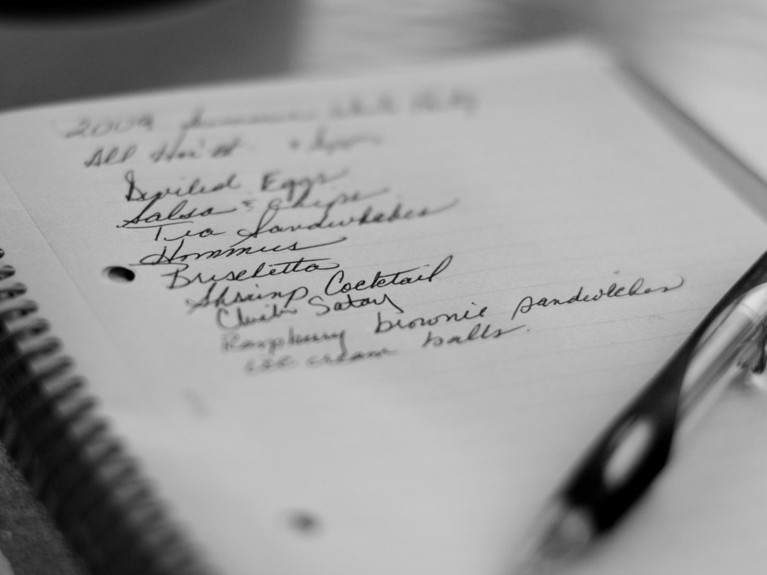
Lists

Slide 2
Wish list

Slide 3
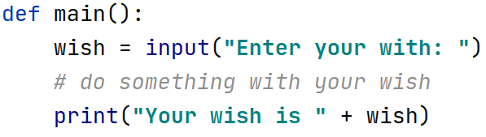

Slide 4
Two wishes?

Slide 5
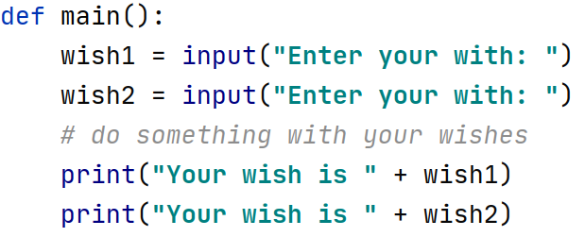

Slide 6
Ten wishes?

Slide 7
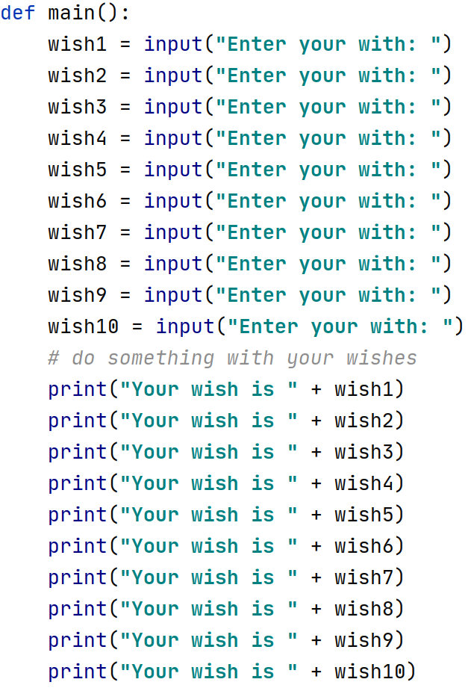

Slide 8


Slide 9
A list is way to keep track of an ordered collection of items
Items in the list are called "elements"
Ordered: can refer to elements by their position
Collection: list can contain multiple items
The list dynamically adjusts its size as elements are added or removed
Lists have a lot of built-in functionality to make using them more straightforward

Slide 10

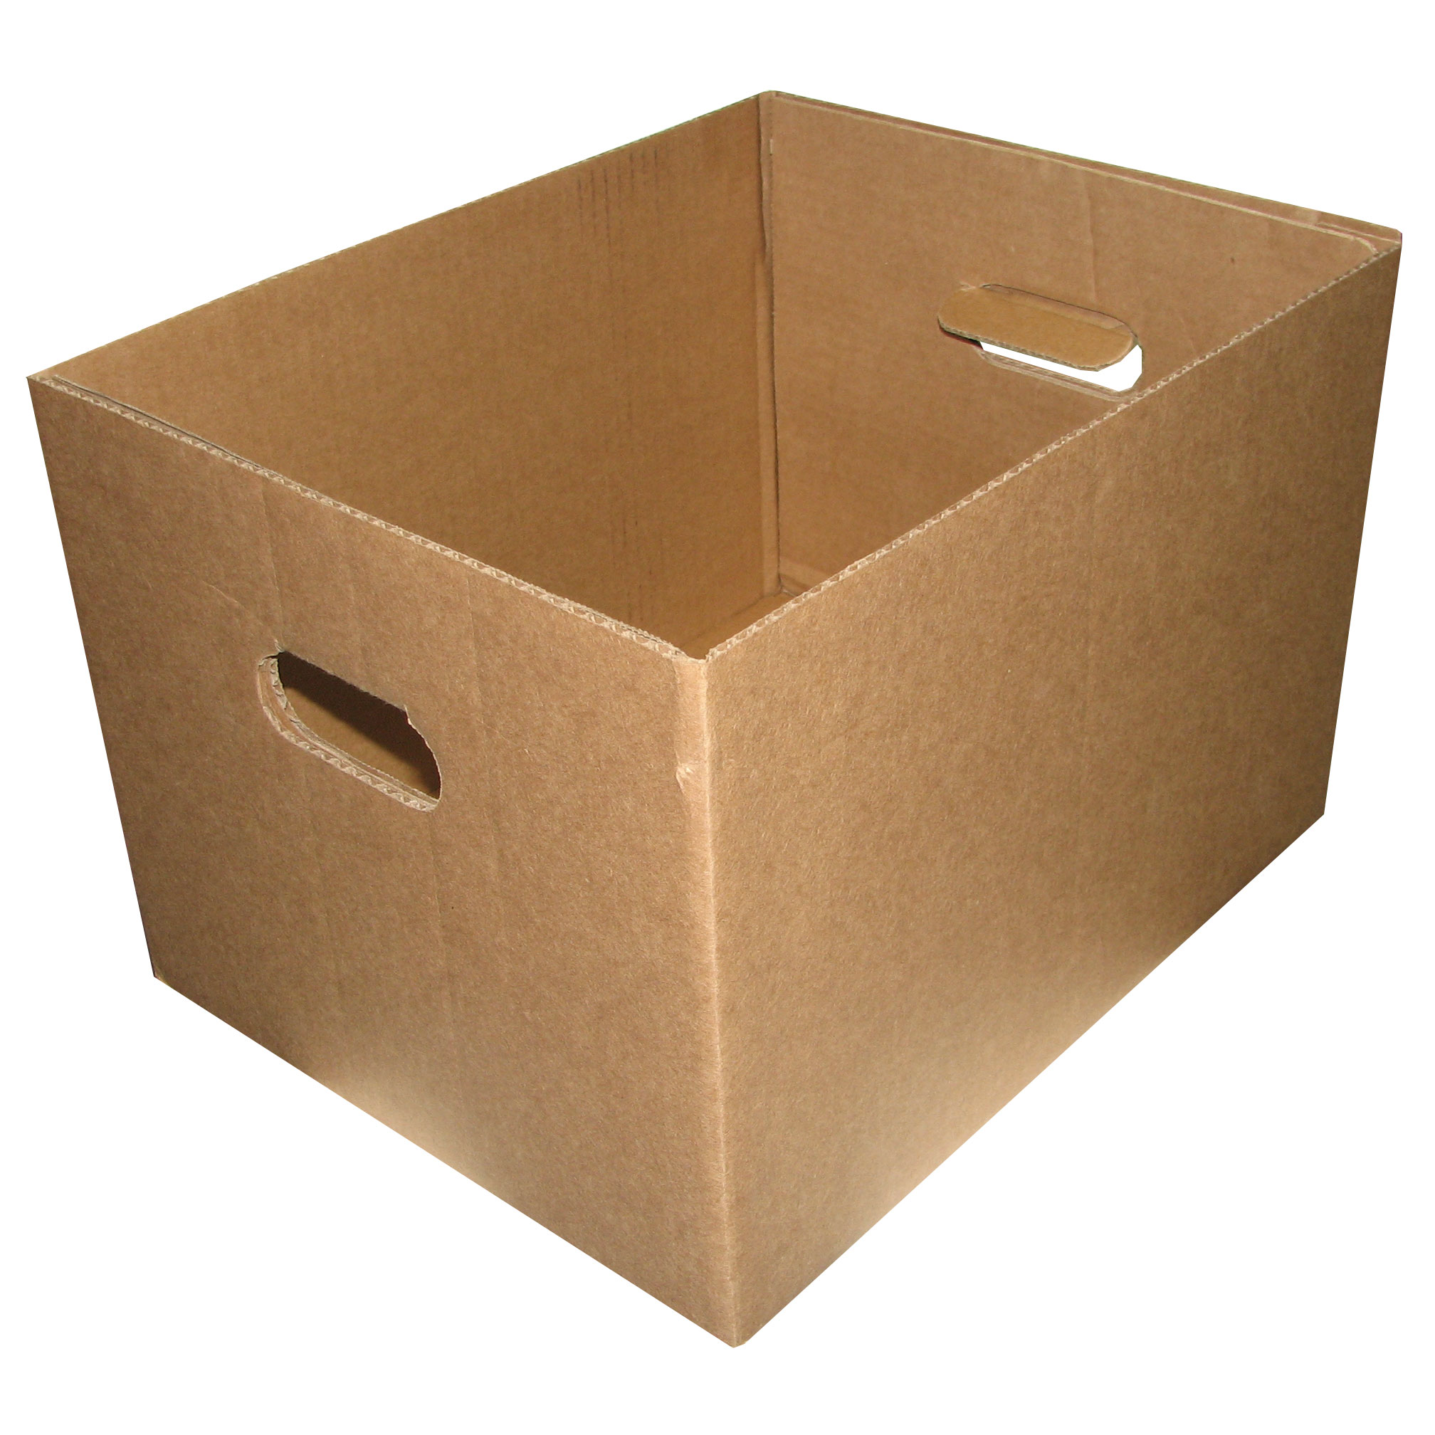
wish

Slide 11
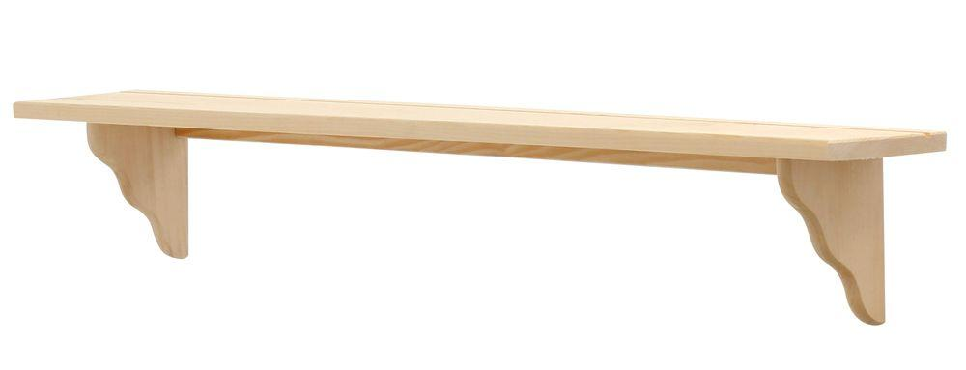

Slide 12
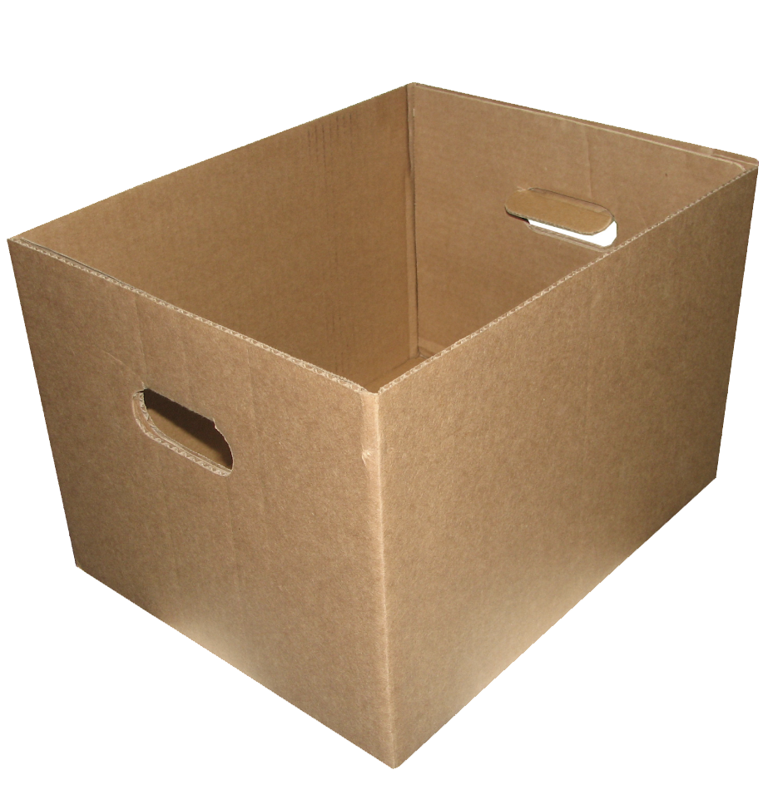

Slide 22
0
1
2
3
4
5
6
7
8
9

Slide 23
0
1
2
3
4
5
6
7
8
9

Slide 24
0
1
2
3
4
5
6
7
8
9

Slide 25
0
1
2
3
4
5
6
7
8

Slide 26
0
1
2
3
4
5
6
7

Slide 27
0
1
2
3
4
5
6
7
8
9

Slide 28
0
1
2
3
4
5
6
7
8
9

Slide 29
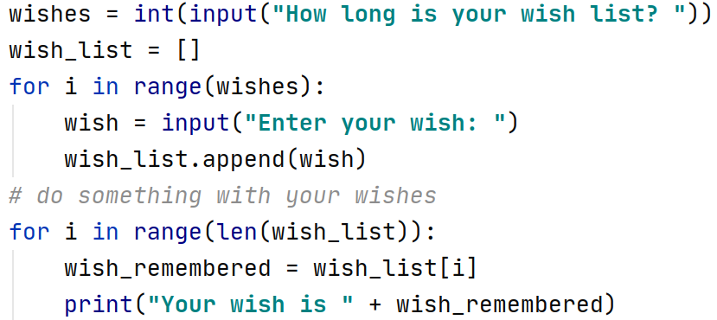

Slide 33
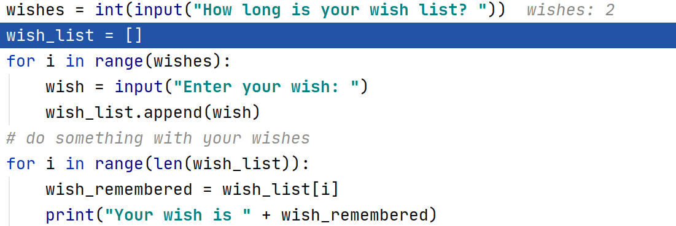

Slide 34
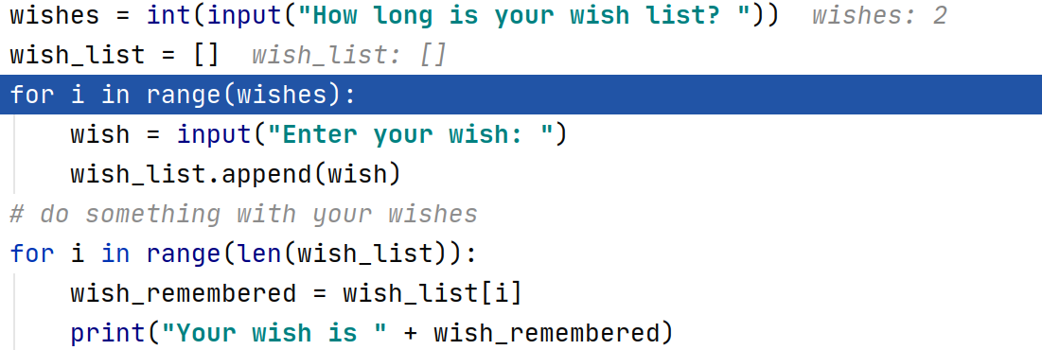

Slide 35
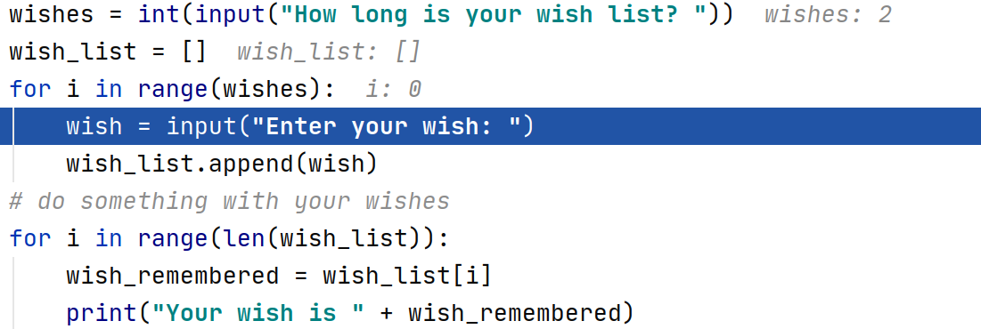

Slide 36
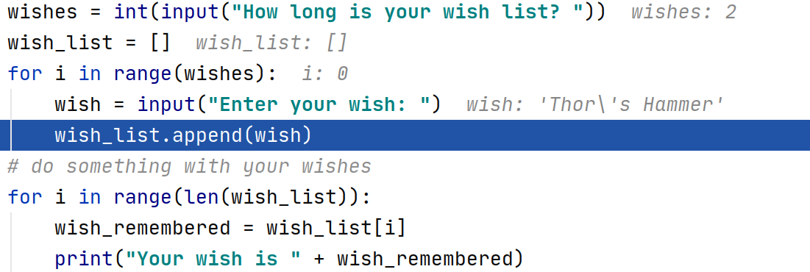

Slide 37
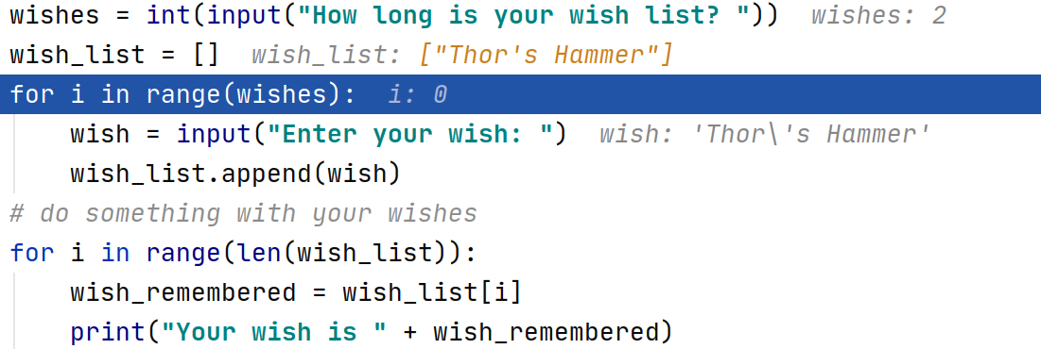
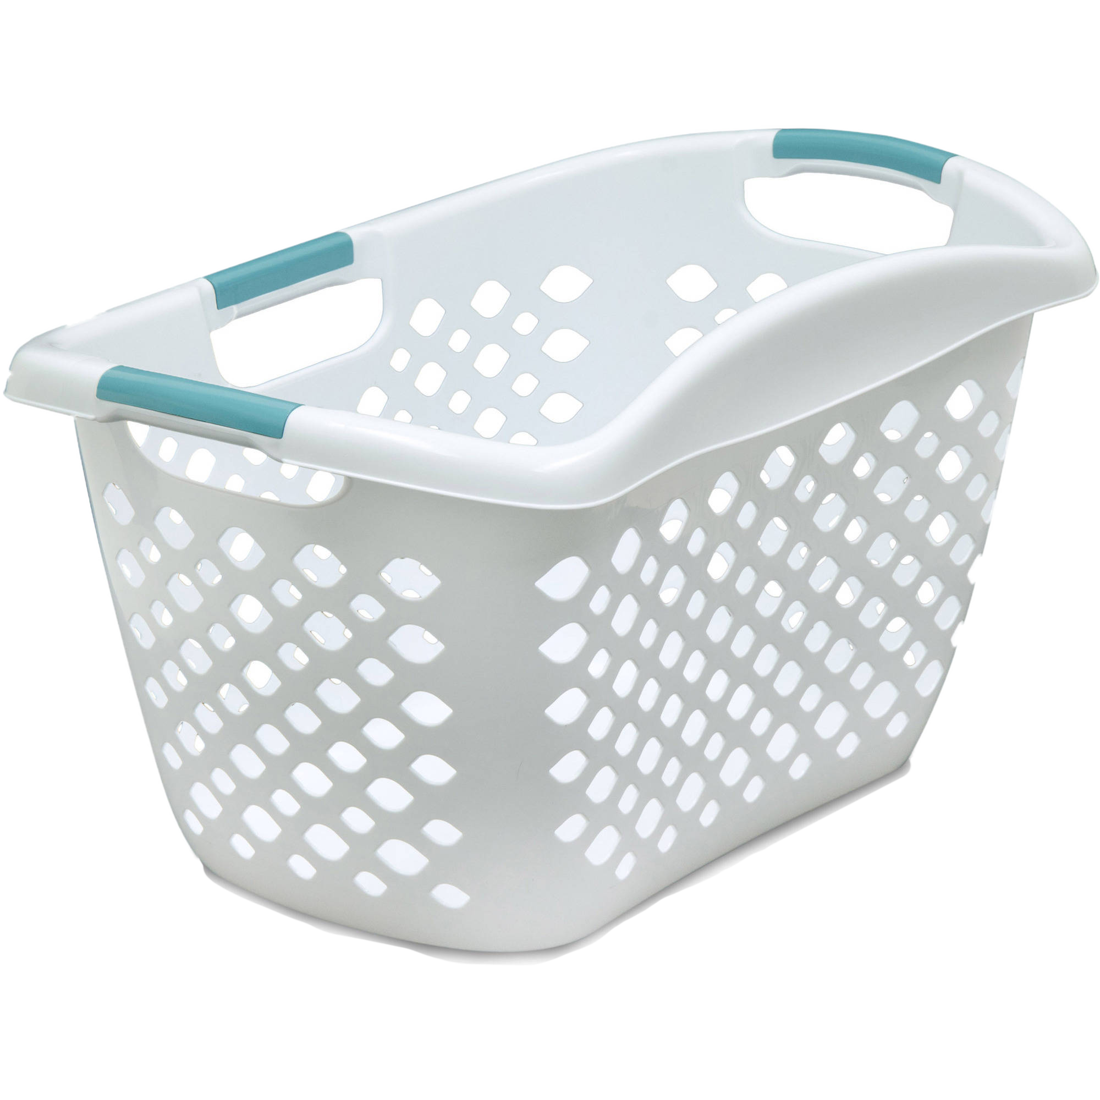
“Thor’s
Hammer”
0

Slide 38
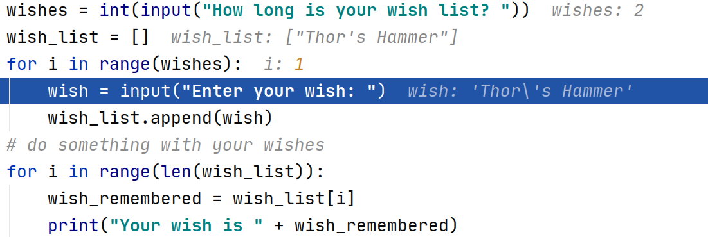
“Thor’s
Hammer”
0

Slide 39
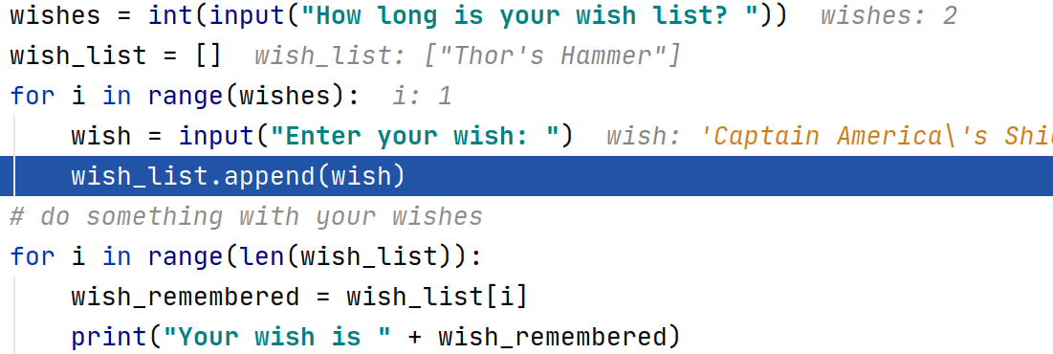
“Thor’s
Hammer”
0

Slide 40
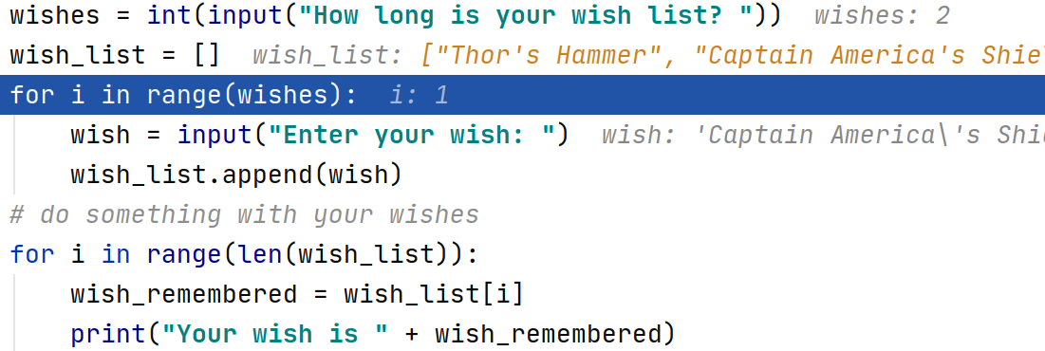
“Thor’s
Hammer”
“Captain
America’s
Shield”
0
1

Slide 41
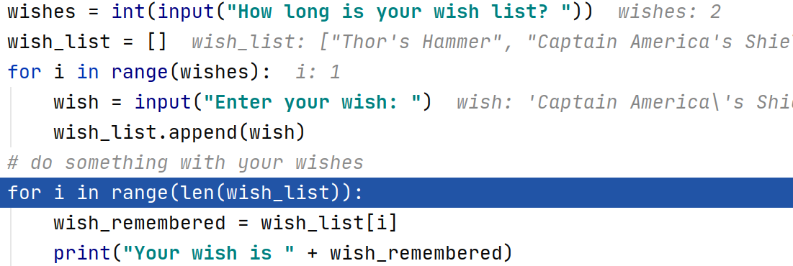
“Thor’s
Hammer”
“Captain
America’s
Shield”
0
1

Slide 42
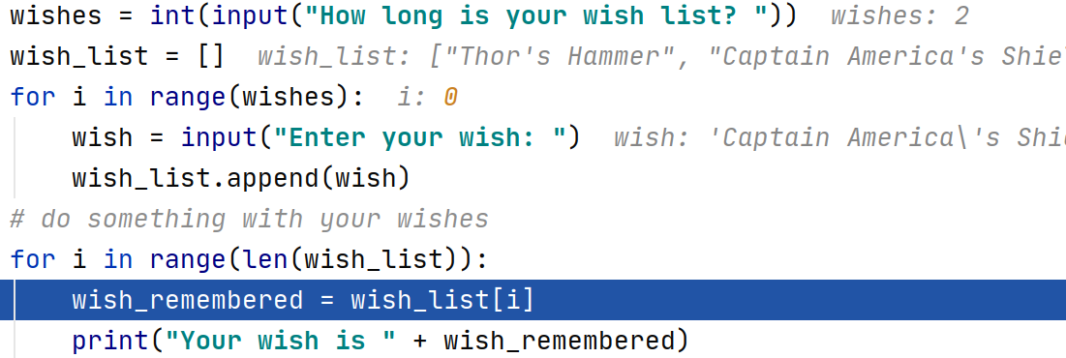
“Thor’s
Hammer”
“Captain
America’s
Shield”
0
1

Slide 43
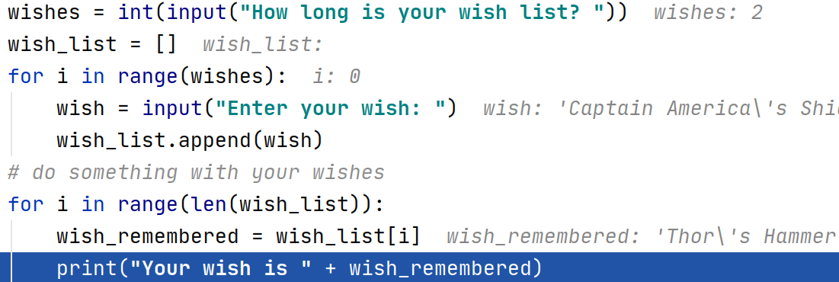
“Thor’s
Hammer”
“Captain
America’s
Shield”
0
1

Slide 44
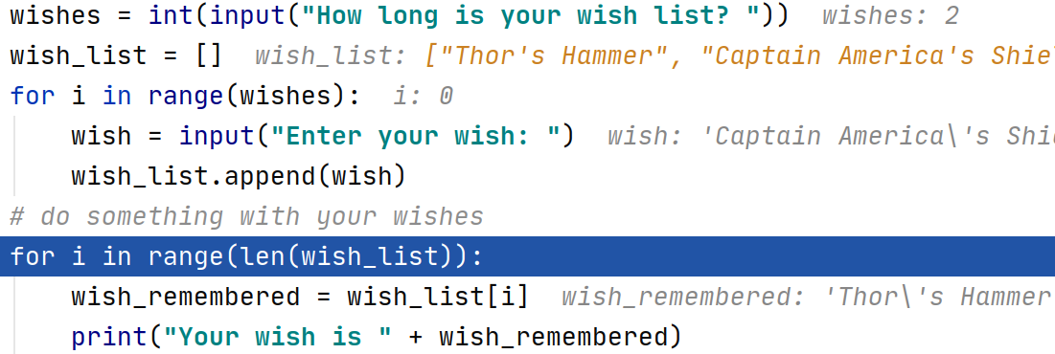
“Thor’s
Hammer”
“Captain
America’s
Shield”
0
1

Slide 45
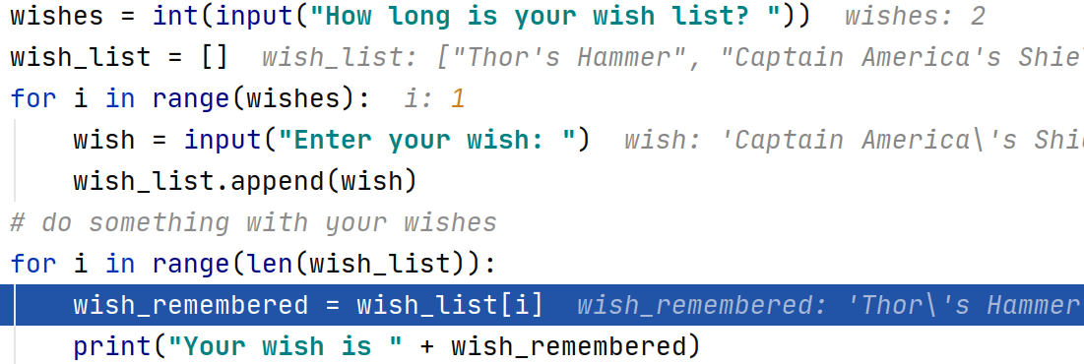
“Thor’s
Hammer”
“Captain
America’s
Shield”
0
1

Slide 46
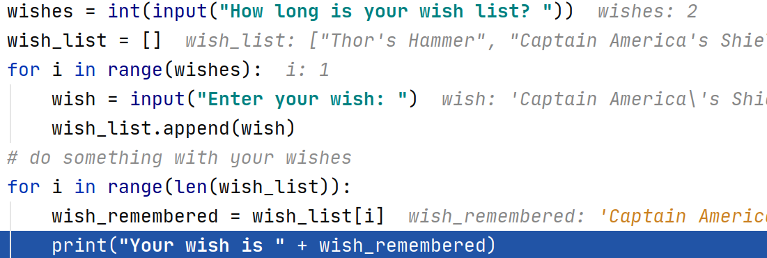
“Thor’s
Hammer”
“Captain
America’s
Shield”
0
1

Slide 47
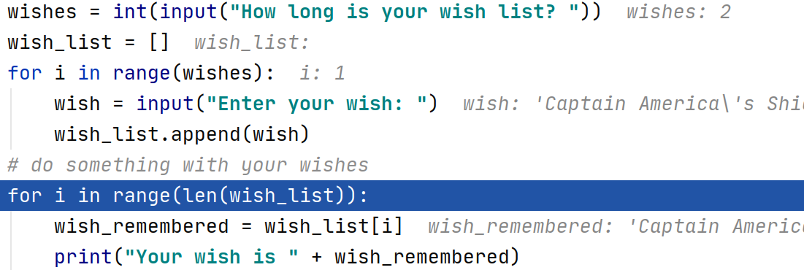
“Thor’s
Hammer”
“Captain
America’s
Shield”
0
1

Slide 48
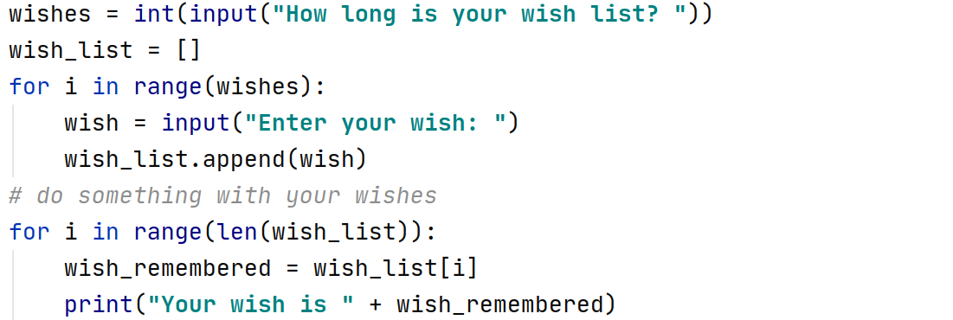
“Thor’s
Hammer”
“Captain
America’s
Shield”
0
1

Slide 49
More fun with lists

Slide 50
“Thor’s
Hammer”
“Captain
America’s
Shield”
0
1

Slide 51
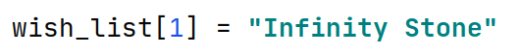
“Thor’s
Hammer”
“Captain
America’s
Shield”
0
1
“Thor’s
Hammer”
“Infinity Stone”
0
1

Slide 52
“Thor’s
Hammer”
“Infinity Stone”
0
1
“Thor’s
Hammer”
“Captain America’s Shield”
“Infinity Stone”
0
1
2

Slide 53
“Thor’s
Hammer”
“Captain America’s Shield”
“Infinity Stone”
0
1
2
Captain America’s Shield
“Thor’s
Hammer”
“Infinity Stone”
0
1

Slide 54
“Thor’s
Hammer”
“Infinity Stone”
0
1
“Thor’s
Hammer”
0
Remove the first matching element

Slide 55
“Thor’s
Hammer”
0
Thor’s Hammer

Slide 56
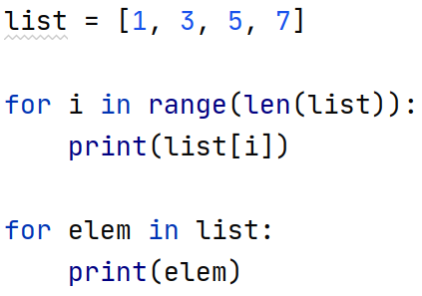

Slide 57
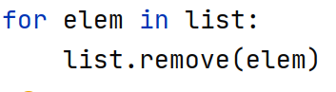

Slide 58
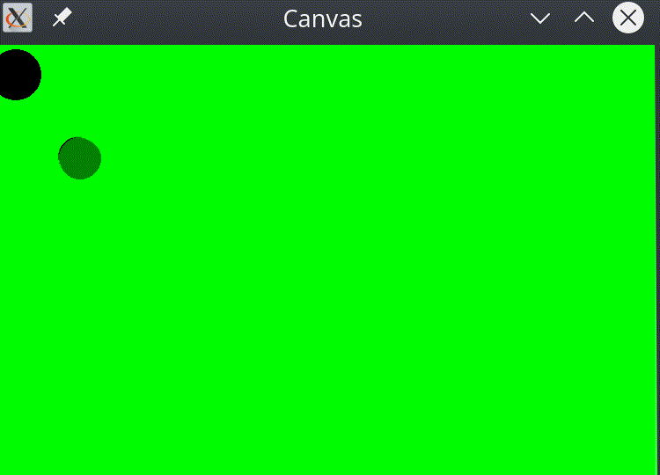

Slide 59
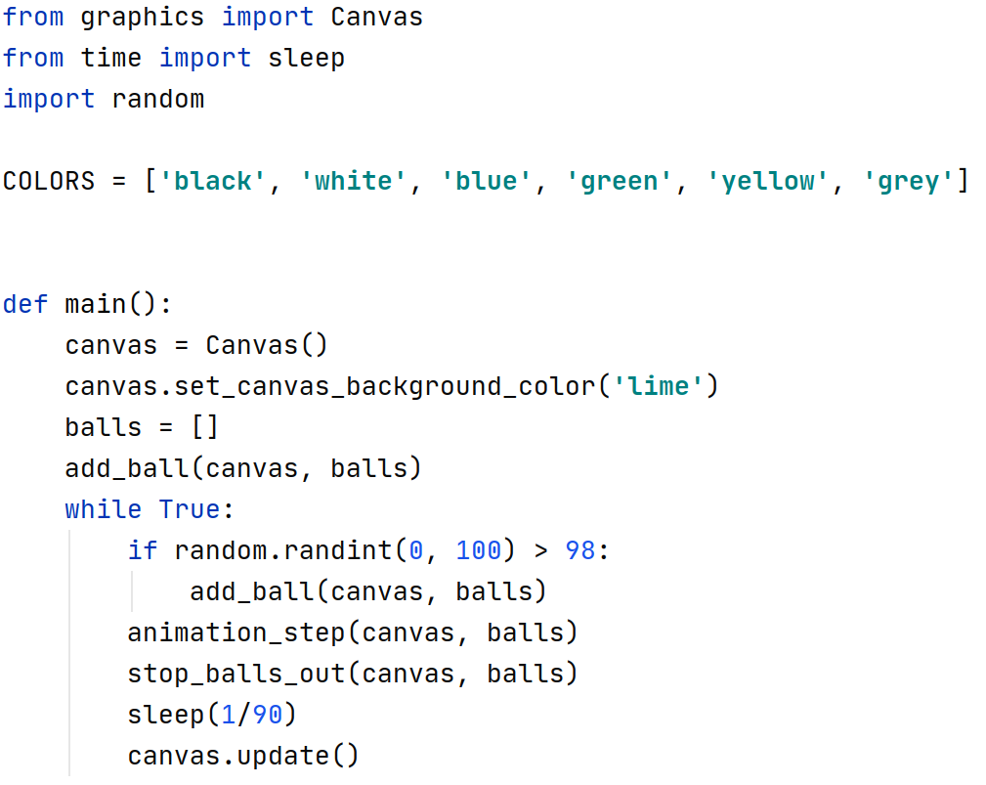

Slide 61
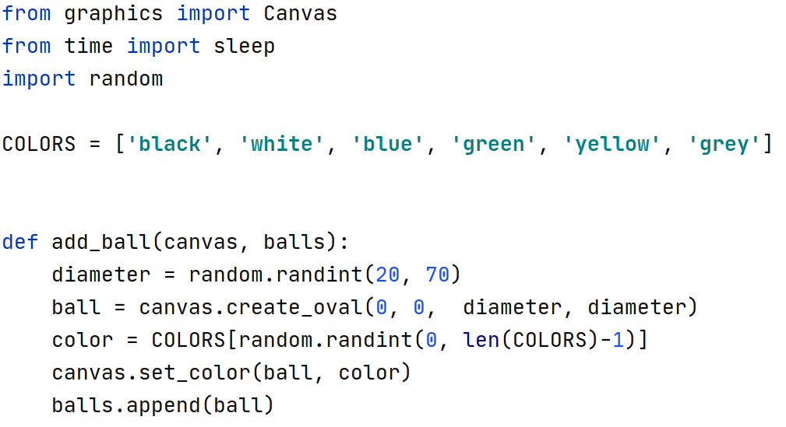

Slide 64
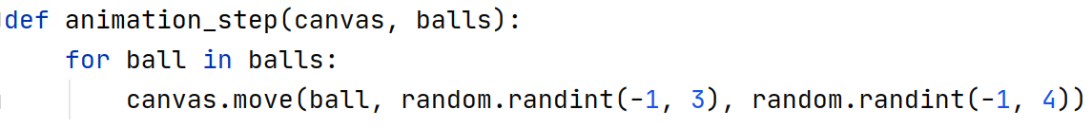

Slide 66
